Slide 1
Slides from the IR Book by Christopher Manning and Prabhakar Raghav
The term vocabulary and postings lists

Slide 2
Consider an index for 1 million documents each having
a length of 1,000 words. Say there are
100K distinct terms in total. We do not wish to keep track
of term-frequency information. What
is the space requirement for a term-document incidence
matrix that does not exploit sparsity?
Answer in terms of Bytes

Slide 3
n = 1M
m = 100K
The full bit-matrix including all zeros would need
n X m entries:
10^6 X 10^5 bits = 10^11 bits = 12.5 GB

Slide 4
Two retrieval systems, X and Y, are being compared.
Both are given the same query, applied
to a collection of 1500 documents.
System X returns 400 documents, of which 40 are relevant
To the query. System Y returns 30 documents,
of which 15 are relevant to the query. Within the
whole collection there are in fact 50 documents relevant
to the query.
Tabulate the results for each system, and compute
the precision and recall for both X and Y.
Show your working.

Slide 5
Evaluation Metrics
Sec. 8.3
Precision: fraction of retrieved docs that are relevant = P(relevant|retrieved)
Recall: fraction of relevant docs that are retrieved
= P(retrieved|relevant)
Precision P =
Recall R =
 | Relevant | Nonrelevant
Retrieved
Not Retrieved

Slide 6
Evaluation Metrics
Sec. 8.3
Precision: fraction of retrieved docs that are relevant = P(relevant|retrieved)
Recall: fraction of relevant docs that are retrieved
= P(retrieved|relevant)
Precision P = tp/(tp + fp)
Recall R = tp/(tp + fn)
 | Relevant | Nonrelevant
Retrieved | tp | fp
Not Retrieved | fn | tn

Slide 7
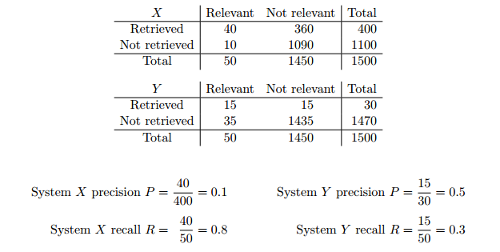

Slide 8
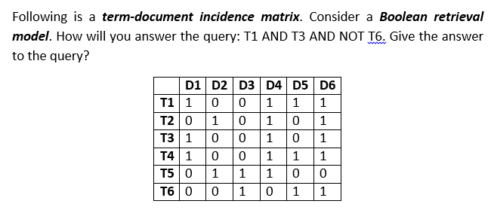

Slide 9
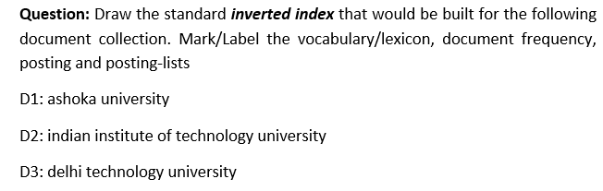

Slide 10
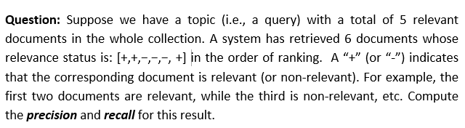

Slide 11
Query optimization
Sec. 1.3
What is the best order for query processing?
Consider a query that is an AND of n terms.
For each of the n terms, get its postings, then AND them together.
Brutus
2
4
8
16
32
64
128
Caesar
1
2
3
5
8
16
21
34
Calpurnia
13
16
Query: Brutus AND Calpurnia AND Caesar

Slide 12
Query optimization example
Sec. 1.3
Process in order of increasing freq:
  start with smallest set, then keep cutting further.
This is why we kept
document freq. in dictionary
Brutus
2
4
8
16
32
64
128
Caesar
1
2
3
5
8
16
21
34
Calpurnia
13
16
Execute the query as (Calpurnia AND Brutus) AND Caesar.

Slide 13
More general optimization
Sec. 1.3
e.g., (madding OR crowd) AND (ignoble OR strife)

Slide 14
More general optimization
Sec. 1.3
e.g., (madding OR crowd) AND (ignoble OR strife)
Get doc. freq.’s for all terms.
Estimate the size of each OR by the sum of its doc. freq.’s (conservative).
Process in increasing order of OR sizes.

Slide 15
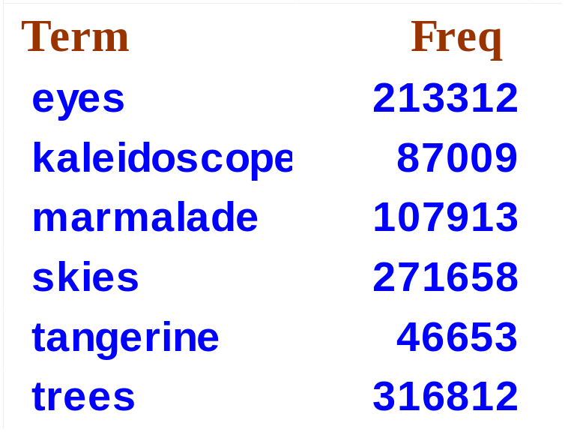
Exercise
Recommend a query processing order for
(tangerine OR trees) AND
(marmalade OR skies) AND
(kaleidoscope OR eyes)

Slide 16
Using the conservative estimate of the length of
unioned postings lists, the recommended order is:
(kaleidoscope OR eyes) (300,321) AND
(tangerine OR trees) (363,465) AND
(marmalade OR skies) (379,571)

Slide 17
For a conjunctive query, is processing postings list in
order of size guaranteed to be optimal? Explain
why it is, or give an example where it is not

Slide 18
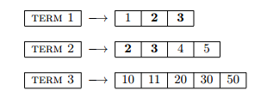
Processing postings list in order of size (i.e. the shortest
postings list first) is usually a good approach.
But it is not optimal e. g. in a conjunctive query with
three terms:
As we can see there is no document containing all three
query terms. If we would have checked the first posting
of the third list right at the beginning, we would have
noticed that there is no intersection
between the first and the third postings list. That would
make any further search superfluous.

Slide 19
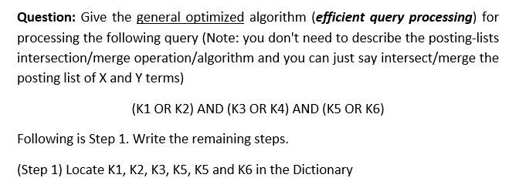

Slide 20
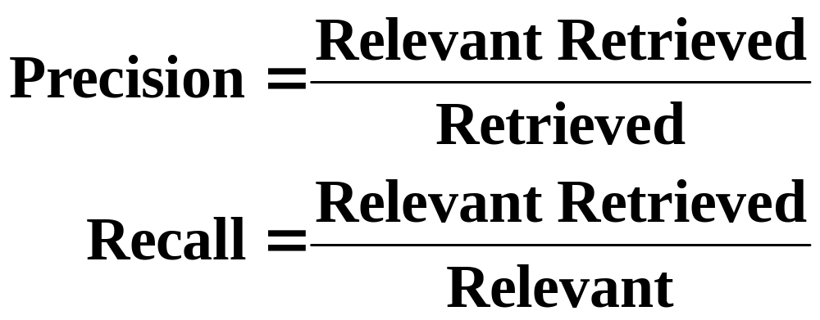
Evaluation Metrics: Classification View
Retrieved
Not Retrieved
Relevant
Relevant Retrieved
Relevant Rejected
Not relevant
Irrelevant Retrieved
Irrelevant Rejected

Slide 21
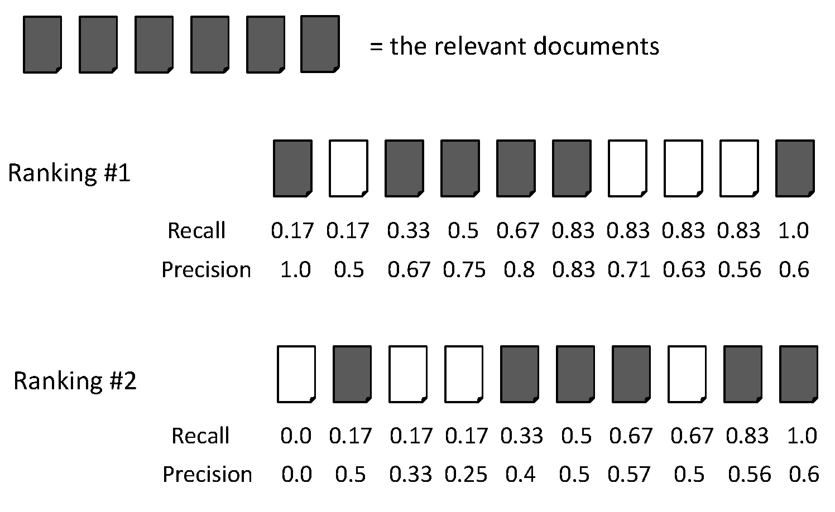
Evaluation Metrics: Example
Recall = 2/6 = 0.33
Precision = 2/3 = 0.67

Slide 22
Evaluation Metrics: Example
Recall = 5/6 = 0.83
Precision = 5/6 = 0.83

Slide 23
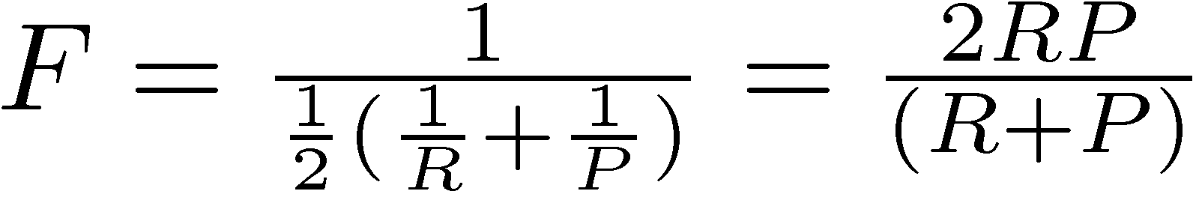
F Measure
Harmonic mean of recall and precision
  Why harmonic mean?
  harmonic mean emphasizes the importance of small values, whereas the arithmetic mean is affected more by outliers that are unusually large

Slide 24
Evaluation Metrics: Example
Recall = 2/6 = 0.33
Precision = 2/3 = 0.67
F = 2*Recall*Precision/(Recall + Precision)
= 2*0.33*0.67/(0.33 + 0.67) = 0.22

Slide 25
Evaluation Metrics: Example
Recall = 5/6 = 0.83
Precision = 5/6 = 0.83
F = 2*Recall*Precision/(Recall + Precision)
= 2*0.83*0.83/(0.83 + 0.83) = 0.83

Slide 26
From Sets to Rankings
Precision and Recall are measures of sets
In a ranked list, we can measure the precision at each recall point
recall increases when a relevant document is
retrieved
compute precision at each relevant retrieved
document, over that fraction of the retrieved
set

Slide 27
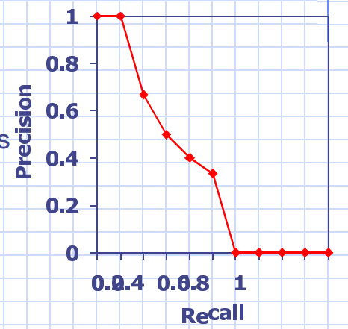
Recall-Precision Graphs
Shows the retrieval
performance at each
point in the ranking
Graph precision at
standard recall points
10%, 20%,…,100%
Interpolate between
points

Slide 28
The recall-precision graph illustrates the tradeoff made by a search algorithm
Shows system performance at multiple operating points
Each user may be interested in a different point on the graph

Slide 29
Performance Evaluation of IR System
often it is useful to have a single number to summarize
performance
Precision at n documents retrieved shows set precision
at fixed points in the ranking
R-precision
Precision when (# relevant documents) retrieved
Average precision
Average of precision at each relevant document
retrieved
Precision of an unretrieved relevant document = 0

Slide 30
Average Precision: Example

Slide 31
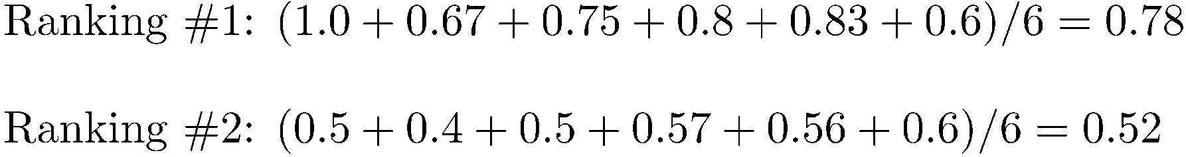
Average Precision: Example

Slide 32
Average Precision: Example

Slide 33
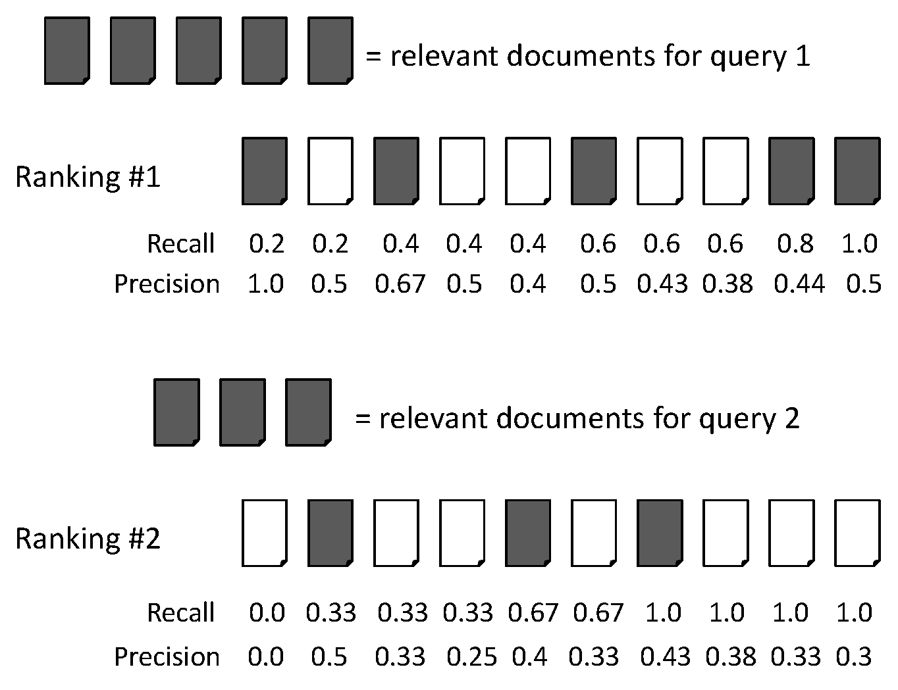
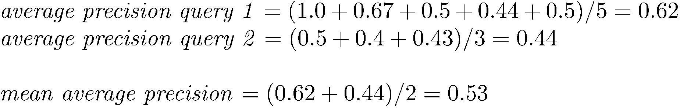
Mean Average Precision (MAP)

Slide 34
Mean Average Precision (MAP)
Summarize rankings from multiple queries by averaging average precision
Most commonly used measure in research papers
Assumes user is interested in finding many relevant documents for each query
Requires many relevance judgments in text collection

Slide 35
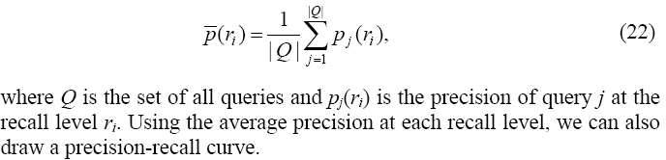
General Formula for MAP
Compute the average precision at each recall level.
CS583, Bing Liu, UIC

Slide 36
Following is the precision-recall graph of an IR system on
a particular topic. 20 documents are retrieved, and that
there are 16 relevant documents for this topic (not all of
which are retrieved). ) In the diagram below, each box
represents a hit. Based on the given precision-recall graph,
which hits are relevant? Write an “R” on the relevant hits.
Leave the non-relevant hits blank.
What is the Mean Average Precision (MAP)?

Slide 37
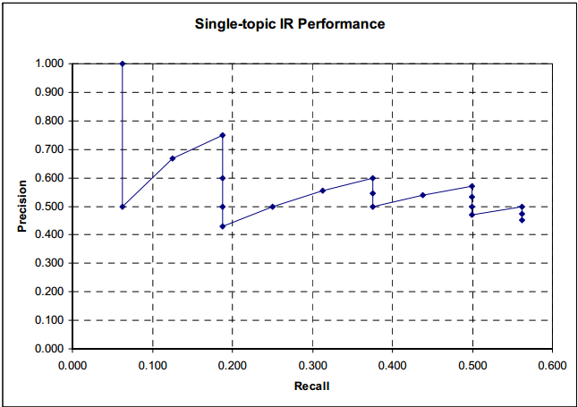
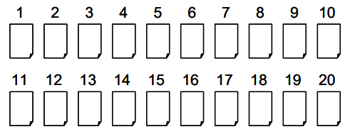

Slide 38
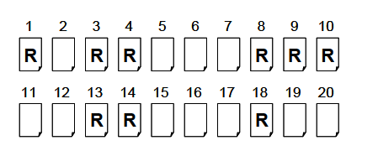
Mean Average Precision
Error: Divide by 9 and not 16

